Slide 1

PT Solutions Benefits Review
Alternate Phone Audio via Teams –or-
(312) 667-5426 #321119938#
November 2023

Slide 2
Agenda
Benefits At a Glance
PT Solutions Benefits website tour
PTS / ActivePro Medical and Dental side-by-side overview
Q&A support
FAQ review

Slide 3
PT Solutions Benefits at a Glance
Medical – Anthem BCBS (2 PPO Plans / 1 HSA Plan)
Dental – Metlife (2 Plans)
Vision – Metlife / VSP
$25k Basic Life and AD&D (paid by PT Solutions)*
Voluntary Employee, Spouse and Child Life
Voluntary Short Term Disability (STD)
Voluntary Long Term Disability (LTD) (50% of premium paid by PT Solutions)*
Flexible Spending Accounts (Medical and Dependent Care)
Health Savings Account (if enrolling in the HDHP medical plan)
  PT Solutions makes an annual HSA employer contribution $500 employee only / $1000 family)*
Critical Illness
Accident
*Legal
401(k) Retirement Plan
*PerkSpot Discount Program
*New or enhanced benefits for ActivePro employees
NOTE: Premiums are deducted 24 pay periods – no benefits deductions on 3rd pay period of a month.

Slide 4
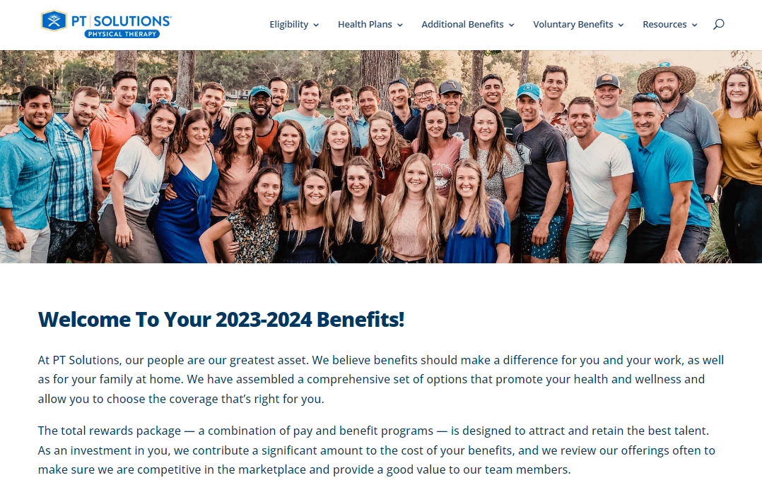
Check out the PT Solutions Benefits website!

Slide 5
Side by side review
Medical and Dental

Slide 6
Medical Benefits Comparison - PPO vs. EPO
Anthem PPO vs Horizon EPO Network
  Horizon EPO (Exclusive Provider Organization) – 1 Plan
    Smaller network of physicians, hospitals and facilities that may vary by market
    No coverage for out of network providers (except for emergencies)
    $1000 deductible Office Visit and Pharmacy copays
  Anthem PPO (Preferred Provider Organization) – 2 Plan Options
    Larger number of in-network physicians, hospitals and facilities
    Coverage also provided for out of network
    $1000 or $1500 deductible options
    Office Visit copays
    Lower Pharmacy copays

Slide 7
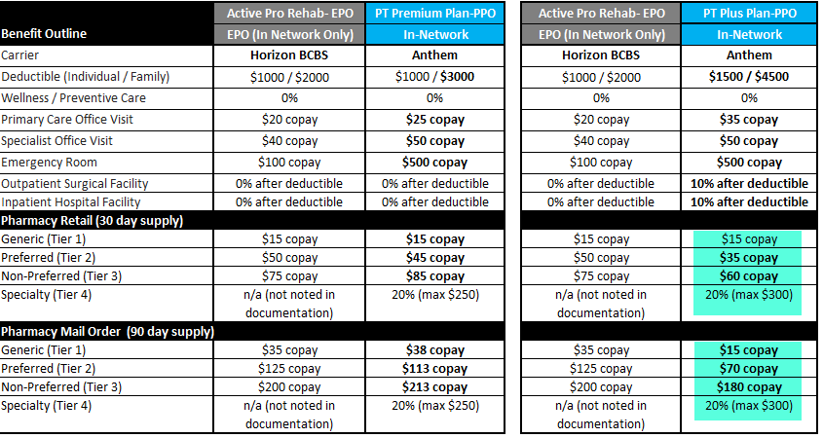
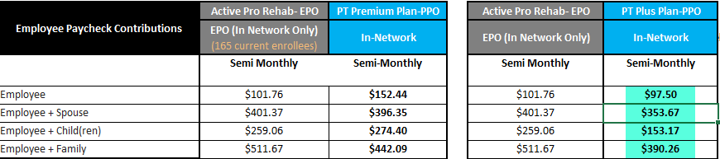

EPO/PPO Medical Side by Side
PTS Most Popular PPO

Slide 8
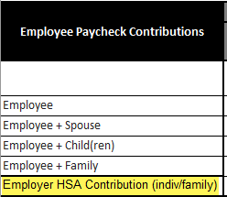
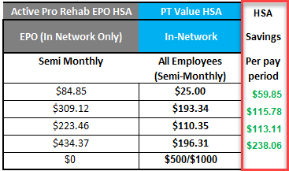
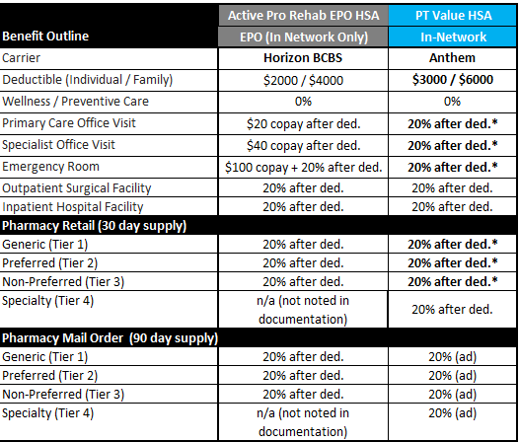
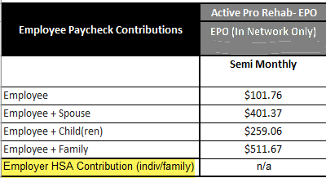
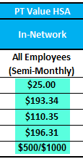

HSA Side by Side
HSA vs PTS HSA cost savings
EPO vs PTS HSA cost savings

Slide 9
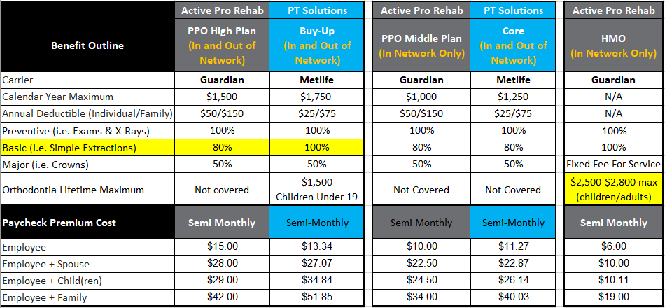
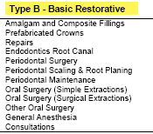
Dental Side by Side
Both provide In and Out of Network coverage
Only PTS Core provides In and Out of Network Coverage

Slide 10
Support and FAQs

Slide 11
Still have questions? We’ve got you covered!
New Benefits Effective Date: January 1, 2024
Open Enrollment: Monday, 11/27 – Monday 12/11
Support:
PT Solutions Benefits Website: ptsolutions.mybenefitport.com
Benefits Assistance Center – Dedicated ActivePro Q&A Support
Hours: Monday – Friday, 8am – 7pm EST
iBTR – One-on-One Enrollment Support 11/27-12/11 – more info to come!
Phone: (833) 288-5473
Email: PTBenefits@bac.Lockton.com

Slide 12
FAQ Review
When will my new benefits under PT Solutions go into effect?
Your benefits will transition to the PT Solutions’ benefit plans effective 1/1/2024, with anticipated enrollment period Monday, November 27 – Monday, December 11, 2023.
Our current benefits plan year is June 1 – May 30. What is PT Solutions’ plan year?
PT Solutions plan year is July 1 – June 30, with Open Enrollment typically in late May. However, deductibles and out of pocket limits are on a January – December calendar year, same as your current ActivePro.
Outside of Open Enrollment, you may make changes to your new PT Solutions benefits elections (or enroll) within 30 days of a qualified life event.
What will the PT Solutions benefits enrollment process look like?
Employees enroll online via the UKG / PlanSource system for new hire enrollment, annual open enrollment, and for any ongoing qualified life event changes that occur throughout the year.
Full details and credentials to access the enrollment system will be provided later in November, prior to the benefits enrollment period.

Slide 13
FAQ Review
What happens to my current vacation and/or sick time?
Your current ActivePro Vacation and Sick Leave policies will remain in effect through 12/31/2023.
If currently eligible under ActivePro vacation and sick policies, you will have continued eligibility under PT Solutions Paid Time Off policies.
Remaining Sick Leave balance as of 12/31/2023 will roll over to PT Solutions and will be maintained for future qualified sick leave purposes.
Further details will follow soon regarding transition to PT Solutions’ PTO, Sick, and Extended Illness Bank (EIB) plans, effective 1/1/2024.
When can I enroll in the PT Solutions 401(k) Plan? Is there an employer match?
The PT Solutions 401(k) Plan provides eligibility for all regularly scheduled full-time and part-time status employees effective January 1, 2024. Further information and separate enrollment instructions will be forthcoming in early December.
The PT Solutions 401(k) Plan provides for an optional, discretionary Company Match Contribution, which is carefully considered on an annual basis and announced each year at the time of January 1 enrollment communications (forthcoming in early December).

Slide 14

Thank you for joining!

